Slide 1

Digital Image Processing
Chapter7: Fourier Transform
Dr. Mohammad Javad Parseh
Jahrom University
Department of Computer Engineering and Information Technology
October 2024

Slide 2
Introduction
The process of converting an image from the spatial domain to the frequency domain provides valuable insight into the nature of the image.
In some cases, an operation can be performed more efficiently in the frequency domain than in the spatial domain.
We focus exclusively on filtering an image in the frequency domain.

Slide 3
Introduction (cont.)
The French mathematician Jean Joseph Fourier developed Fourier transforms in an attempt to solve the heat equation.
During the process, he recognized that a function can be expressed as infinite sums of sines and cosines of different frequencies, now known as the Fourier series.
The Fourier transform is a representation in which any function can be expressed as the integral of sines and cosines multiplied with the weighted function.
Also, any function represented in either Fourier series or transform can be reconstructed completely by an inverse process. This is known as inverse Fourier transform.

Slide 4
Introduction (cont.)
Since the development of the Fast Fourier Transform algorithm (FFT) the applications of Fourier transforms have affected several fields including remote sensing, signal processing and image processing.
In image processing, Fourier transforms are used for the following:
Image filtering
Image compression
Image enhancement
Image restoration
Image analysis
Image reconstruction

Slide 5
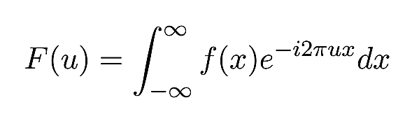
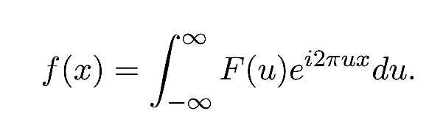
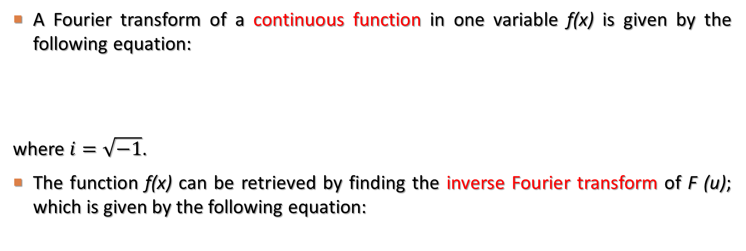
Definition of Fourier Transform
A Fourier transform of a continuous function in one variable f(x) is given by the following equation:
where $i=\sqrt{−1}$.
The function f(x) can be retrieved by finding the inverse Fourier transform of F (u); which is given by the following equation:

Slide 6
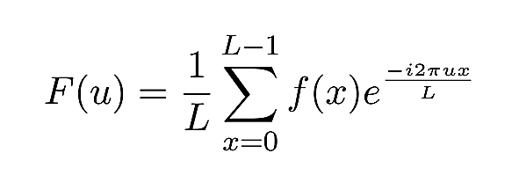
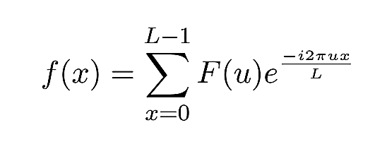
Definition of Fourier Transform (cont.)
The Fourier transform of a one-variable discrete function, f(x) for x, u = 0, 1, …, L − 1 is given by the following equation (DFT):
Likewise, the inverse discrete Fourier transform, IDFT for x, u = 0, 1, …, L − 1 is given by the following equation:

Slide 7
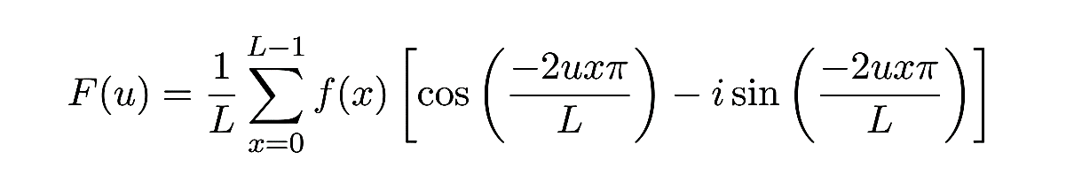
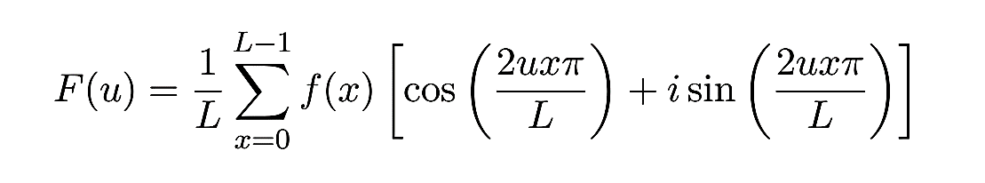
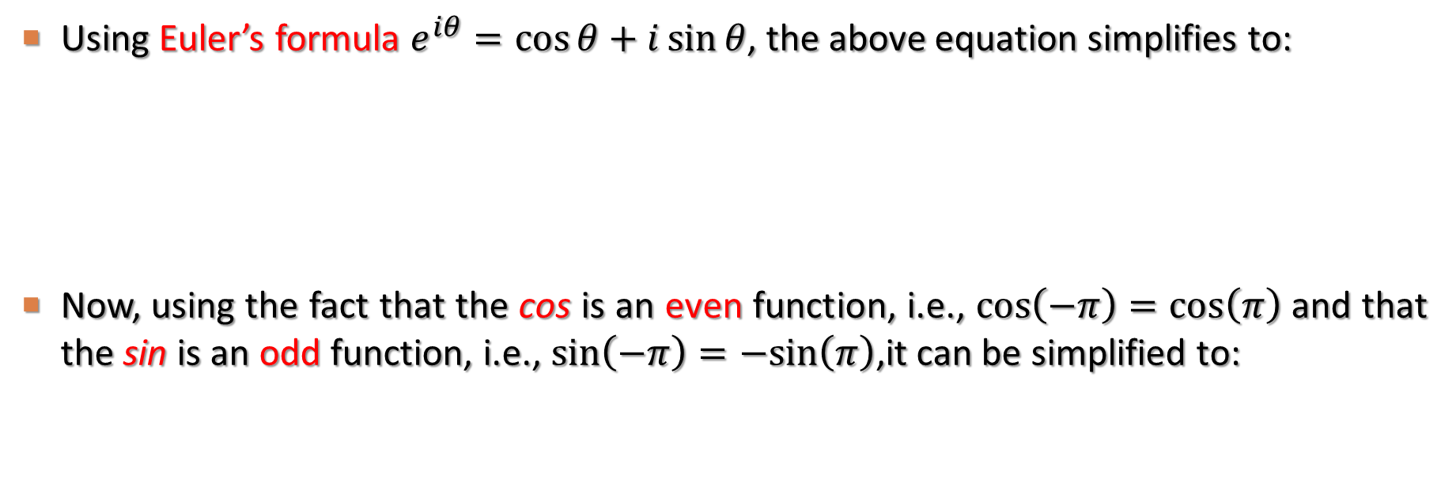
Definition of Fourier Transform (cont.)
Using Euler’s formula $e^{iθ}=\cos{θ}+i\sin{θ}$, the above equation simplifies to:
Now, using the fact that the cos is an even function, i.e., $\cos\left(−π\right)=\cos\left(π\right)$ and that the sin is an odd function, i.e., $\sin\left(−π\right)=−sin\left(π\right)$,it can be simplified to:

Slide 8
Definition of Fourier Transform (cont.)
Each term of F(u) is known as the coefficient of the Fourier transform.
real part (R(u))
imaginary part (I(u))
frequency variable
spatial variable

Slide 9
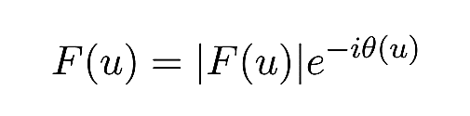
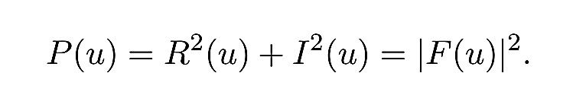
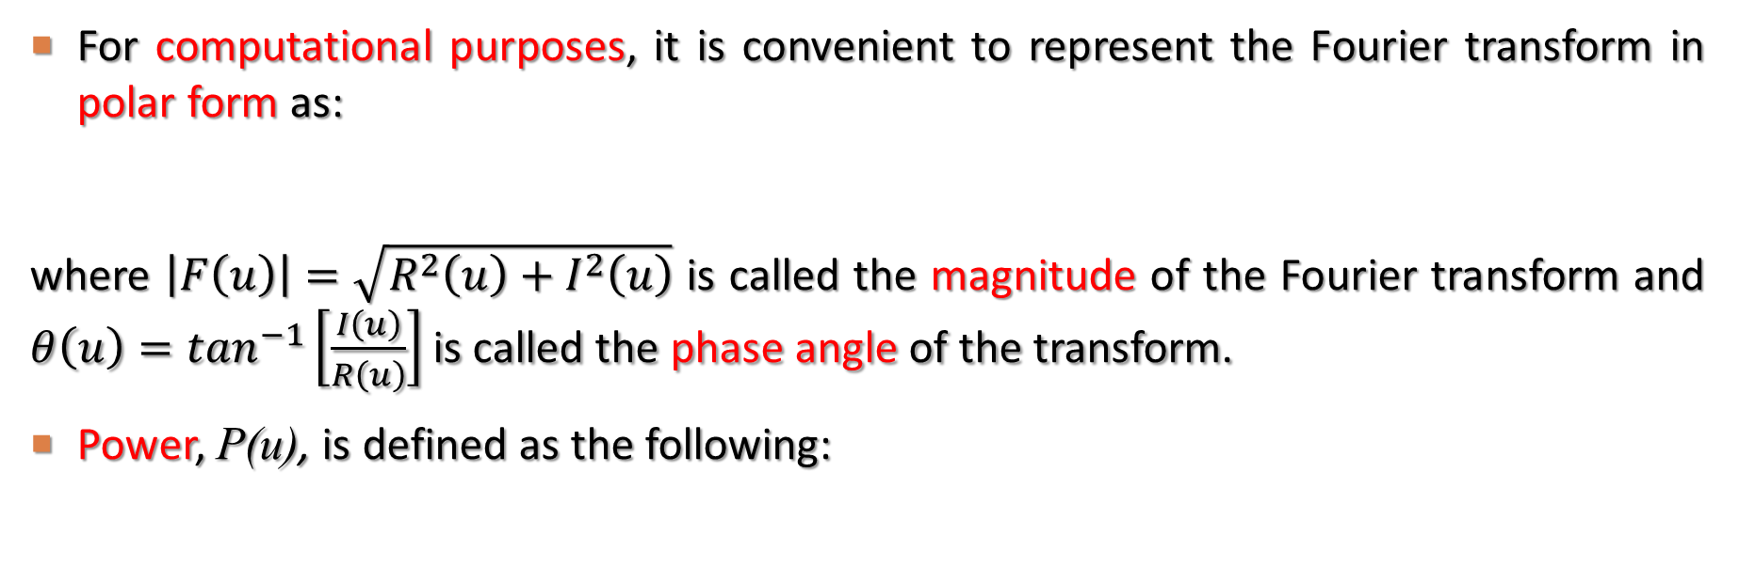
Definition of Fourier Transform (cont.)
For computational purposes, it is convenient to represent the Fourier transform in polar form as:
where $\left|F\left(u\right)\right|=\sqrt{R^{2}\left(u\right)+I^{2}\left(u\right)}$ is called the magnitude of the Fourier transform and $θ\left(u\right)=\tan^{−1}\left[\frac{I\left(u\right)}{R\left(u\right)}\right]$ is called the phase angle of the transform.
Power, P(u), is defined as the following:

Slide 10
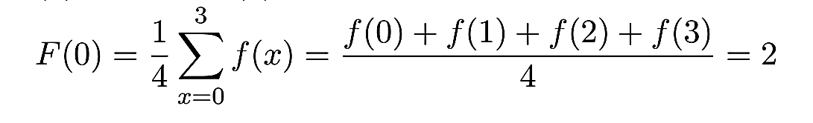
Definition of Fourier Transform (cont.)
F(0) is nothing but the average of f(x) since e⁰ = 1. F(0) has a non-zero real part while the imaginary part is zero.
Let f(x) be a discrete function with only four values: f(0) = 2, f(1) = 3, f(2) = 2, f(3) = 1. Note that the size of f is 4, hence L = 4.

Slide 11
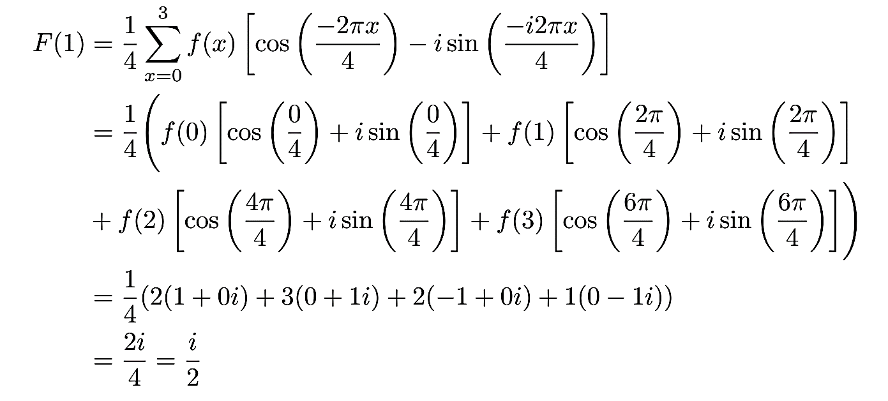
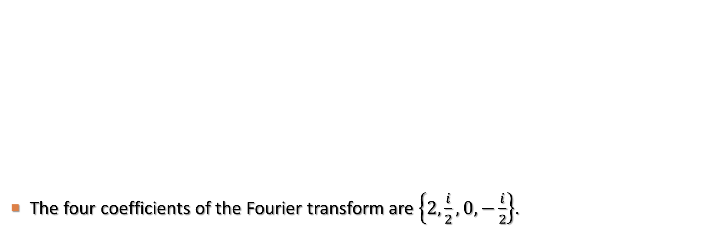
Definition of Fourier Transform (cont.)
The four coefficients of the Fourier transform are $\left\{2, \frac{i}{2}, 0, −\frac{i}{2}\right\}$.

Slide 12
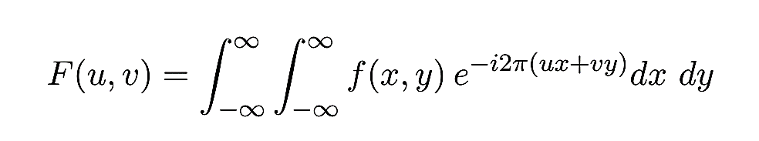
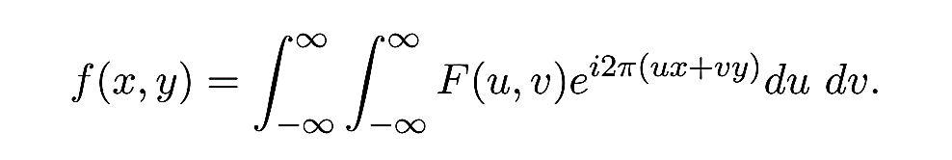
Two-Dimensional Fourier Transform
The Fourier transform and the inverse Fourier transform for two variables are given by the following equations:

Slide 13
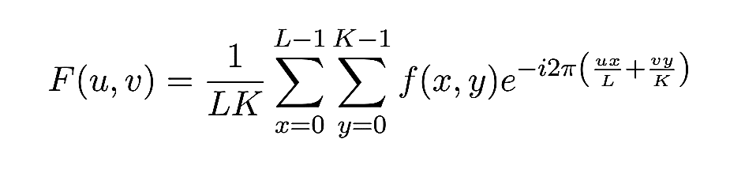
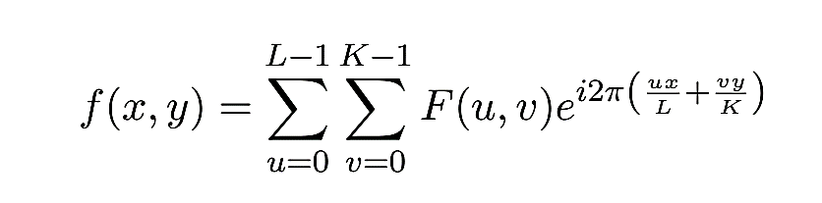
Two-Dimensional Fourier Transform (cont.)
The discrete Fourier transform and the inverse discrete Fourier transform of a 2D function, f(x, y) with size L and K is given by the following equation: (x, u = 1, 2, …, L−1 and y, v = 1, 2, …, K−1)

Slide 14
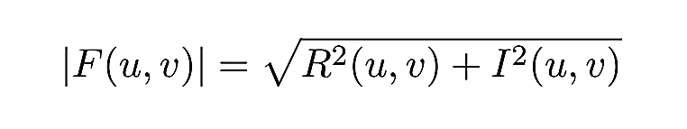
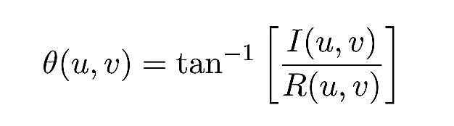
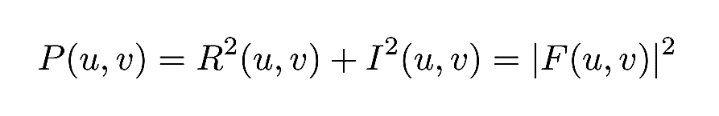
Two-Dimensional Fourier Transform (cont.)
As in the case of 1D DFT, u and v are the frequency variables and x and y are the spatial variables. The magnitude, phase and power of the Fourier transform in 2D is given by the following equation:

Slide 15
2D Fourier Transform Properties
The 2D spaces with (x, y) and (u, v) as variables are referred to as the spatial domain and frequency domain respectively.
F(0, 0) is the average of all pixel values in the image. Hence F(0, 0) is the brightest pixel in the Fourier transform image.
The computational complexity of DFT is N². Hence a modified method called Fast Fourier Transform (FFT) is used to calculate the Fourier transform. FFT has a complexity of NlogN and hence the word “Fast” in its name.

Slide 16
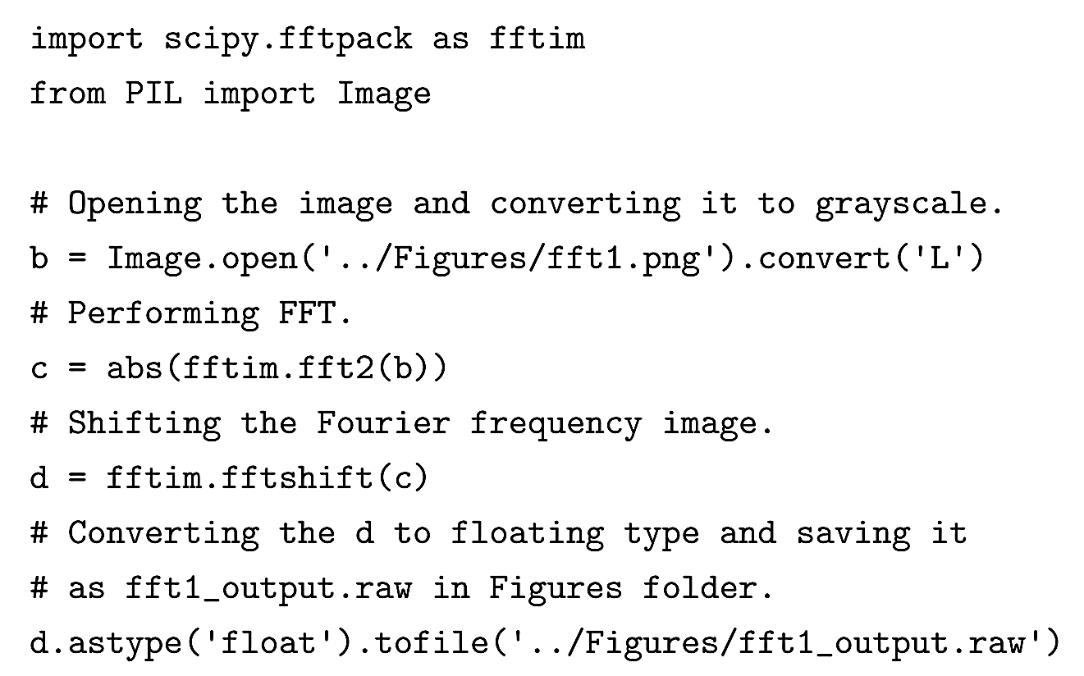
Fast Fourier Transform using Python

Slide 17
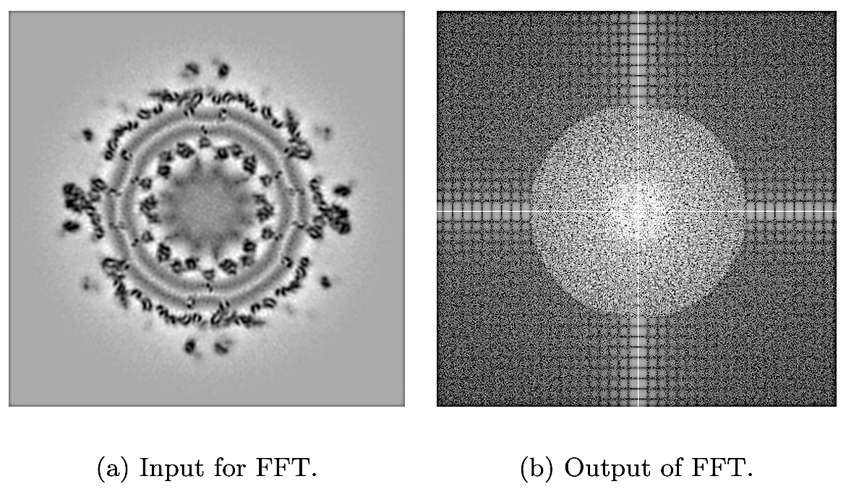
Fast Fourier Transform using Python (cont.)

Slide 18
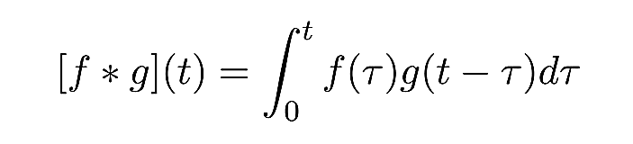
Convolution
Convolution is a mathematical operation that expresses the integral of the overlap between two functions.
The convolution operation is expressed mathematically as:
where f, g are the two functions and the * (asterisk) represents convolution.

Slide 19
Convolution (cont.)
The convolution satisfies the following properties:
f ∗ g = g ∗ f Commutative Property
f ∗ (g ∗ h) = (f ∗ g) ∗ h Associative Property
f ∗ (g + h) = f ∗ g + f ∗ h Distributive Property
The convolution operation is simpler in Fourier space than in real space.
In Fourier space, convolution is performed on the whole image at once. However, in spatial domain convolution is performed by sliding the filter window on the image.

Slide 20
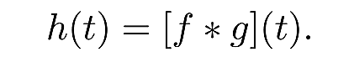
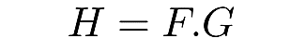
Convolution in Fourier Space
Let us assume that the convolution of f and g in spatial domain is the function h:
If the Fourier transform of this function is H; then H is defined as:
where F and G are the Fourier transforms of the functions f and g respectively and the “.” (dot) represents multiplication.
Thus, in Fourier space the complex operation of convolution is replaced by a simpler multiplication.

Slide 21
Filtering in the Frequency Domain
In low-pass filters, only low frequencies from the Fourier transform are used while high frequencies are blocked.
Similarly, in high-pass filters, only high frequencies from the Fourier transform are used while the low frequencies are blocked.
Low-pass filters are used to smooth the image or reduce noise, whereas high-pass filters are used to sharpen edges.
In each case, three different filters, namely, ideal, Butterworth and Gaussian, are considered.

Slide 22
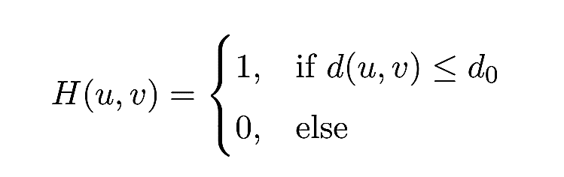
Ideal Low-pass Filter
The convolution function for the 2D ideal low-pass filter (ILPF) is given by:
here d₀ is a specified quantity and d(u,v) is the Euclidean distance from the point (u, v) to the origin of the Fourier domain.
Note that for an image of size M by N, the coordinates of the origin are (M/2, N/2).
So d₀ is the distance of the cut-off frequency from the origin.

Slide 23
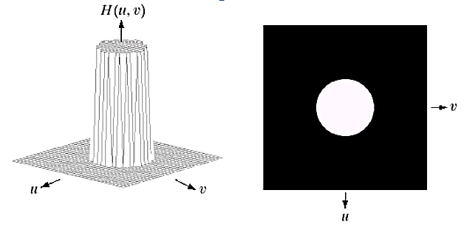
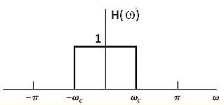
Ideal Low-pass Filter (cont.)
For a given image, after the convolution function is defined, the ideal low-pass filter can be performed with element-by-element multiplication of the FFT of the image and the convolution function.
Then the inverse FFT is performed on the convolved function to get the output image.

Slide 24
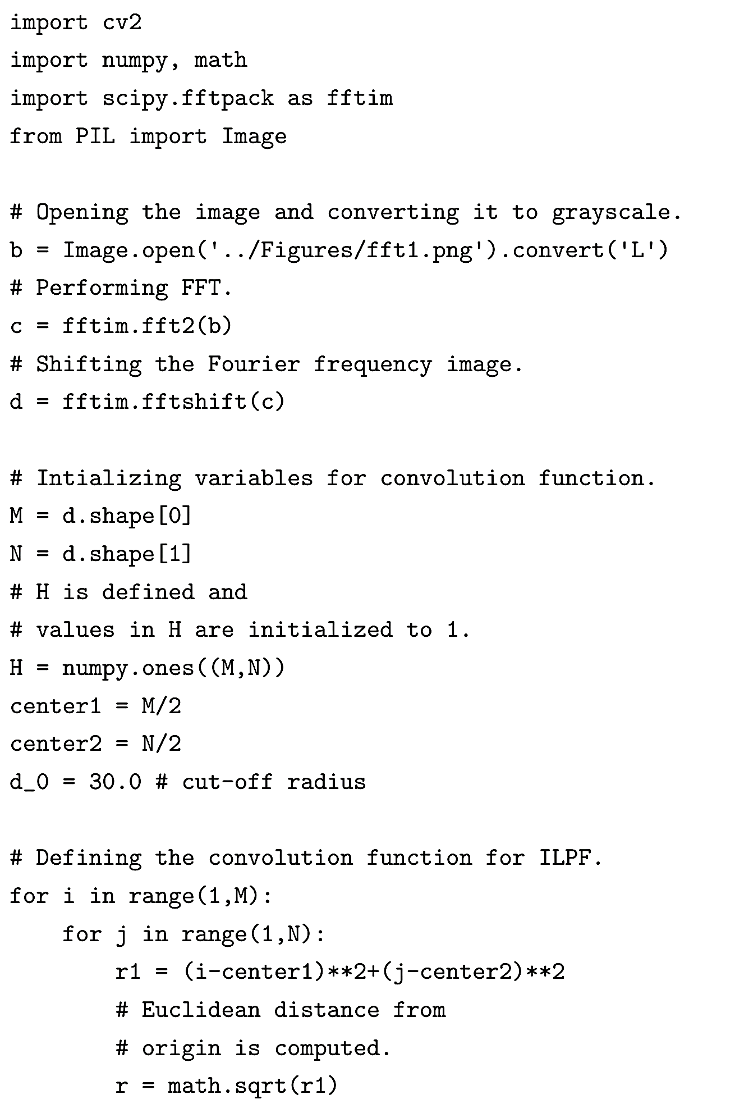
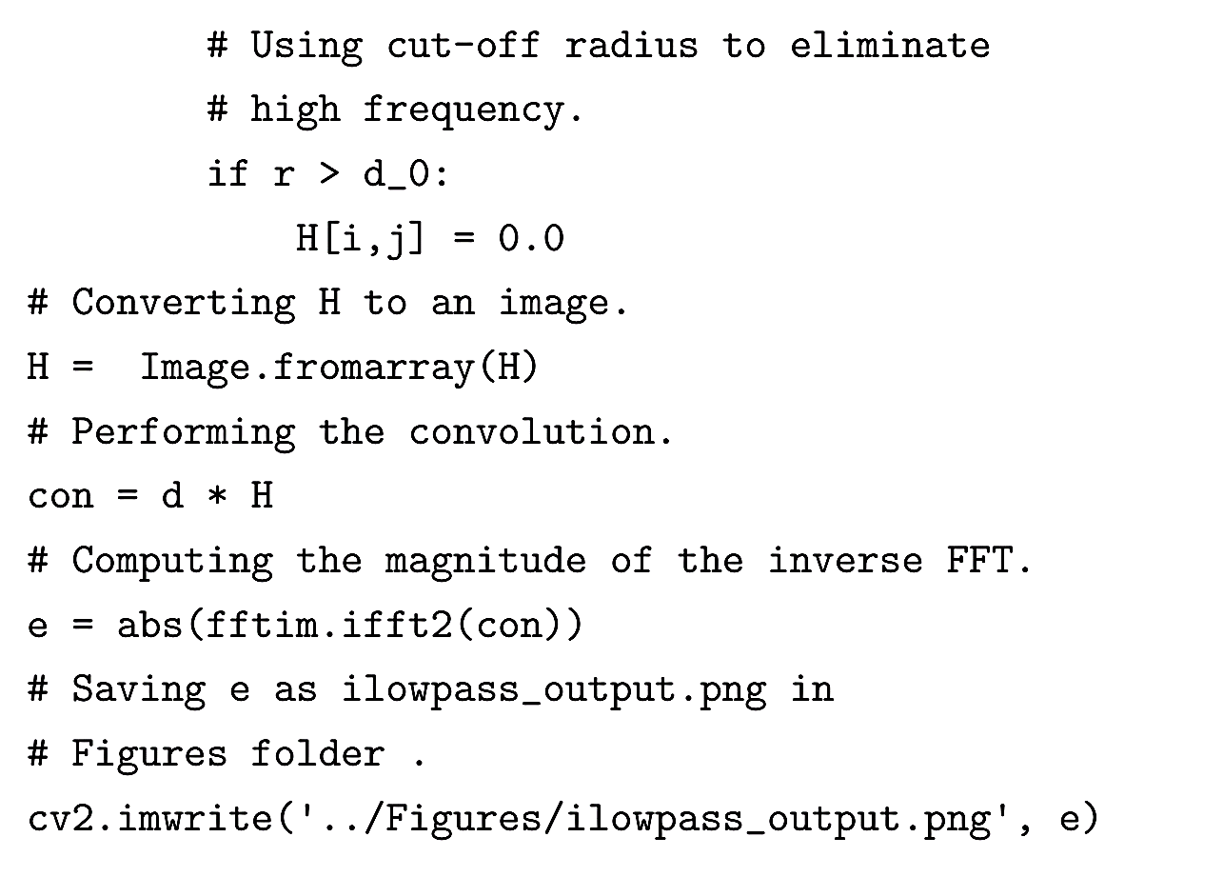
Ideal Low-pass Filter (cont.)

Slide 25
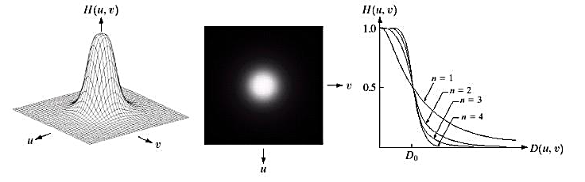
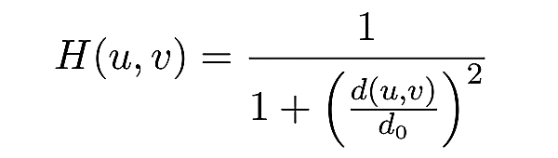
Butterworth Low-pass Filter
The convolution function for the Butterworth lowpass filter (BLPF) is given below:
where d₀ is the cut-off distance from the origin for the frequency and d(u, v) is the Euclidean distance from the origin.
In this filter, unlike the ILPF, the pixel intensity at the cut-off radius does not change rapidly.

Slide 26
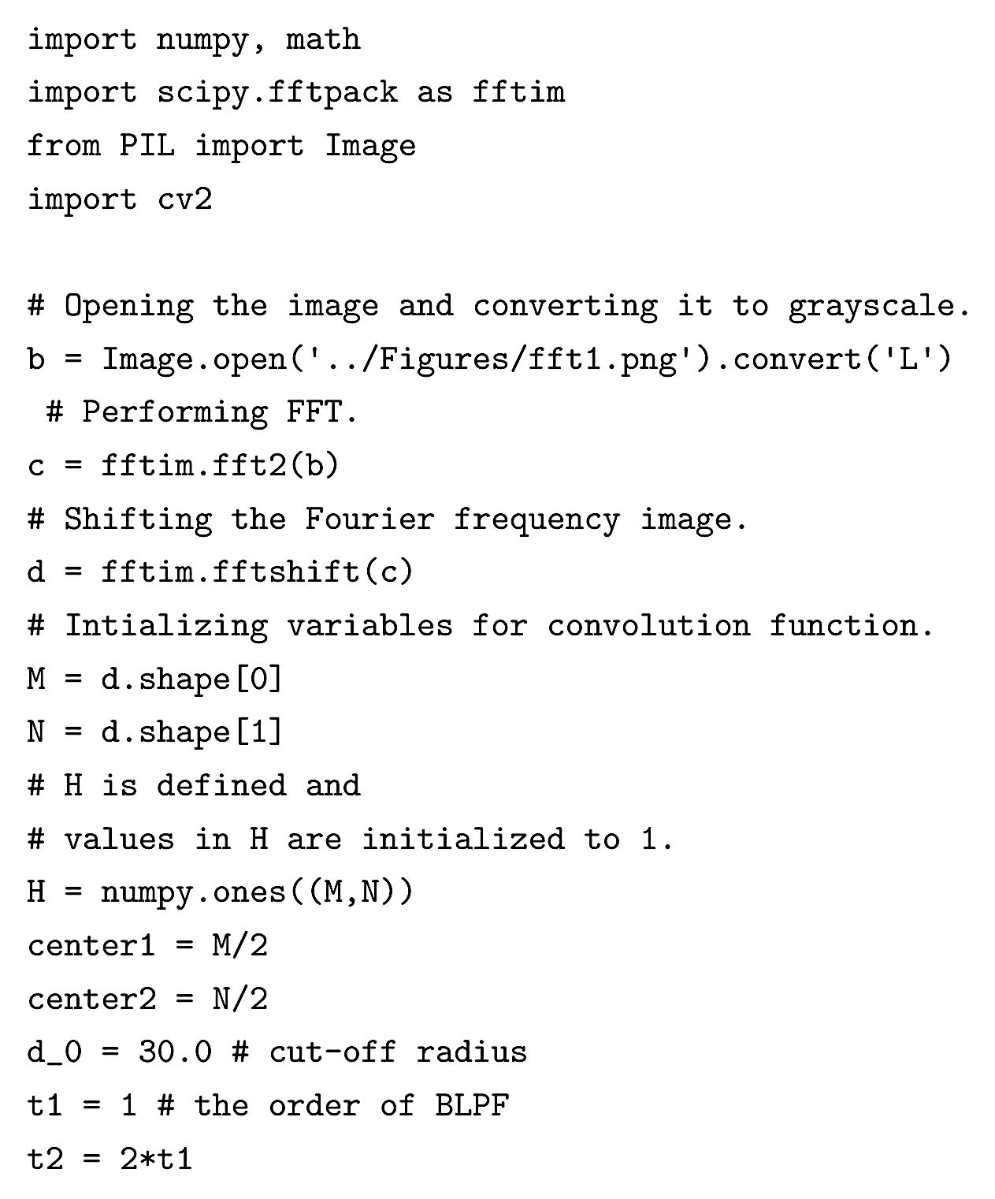
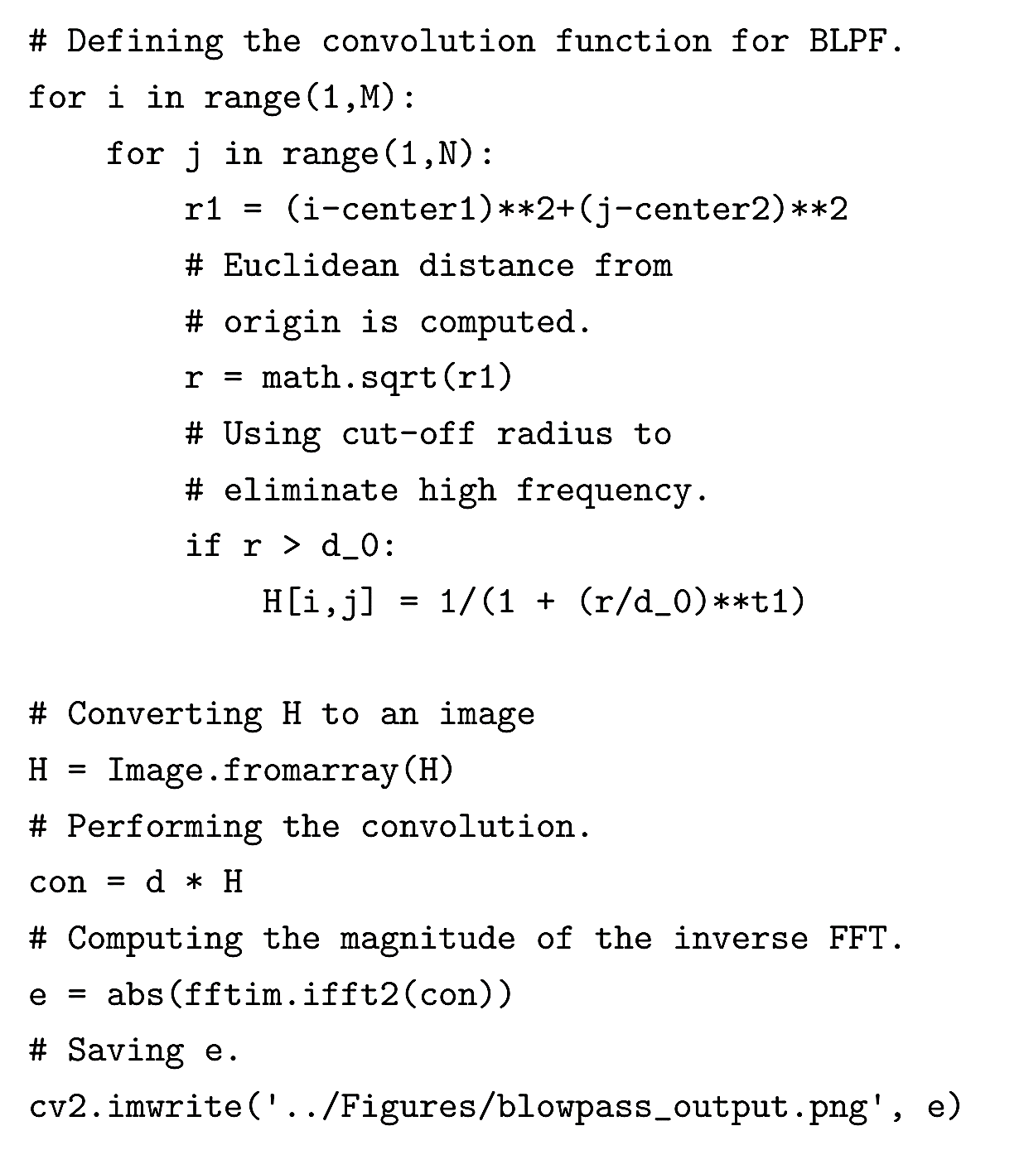
Butterworth Low-pass Filter (cont.)

Slide 27
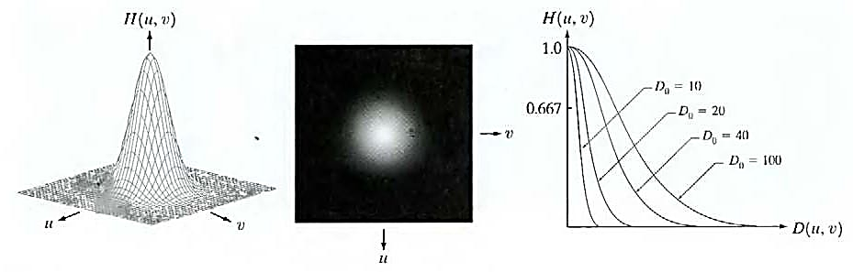
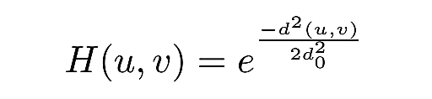
Gaussian Low-pass Filter
The convolution function for the Gaussian low-pass filter (GLPF) is given below:
where d₀ is the cut-off frequency and d(u, v) is the Euclidean distance from origin.
The filter creates a much more gradual change in intensity at the cut-off radius compared to the Butterworth low-pass filter.

Slide 28
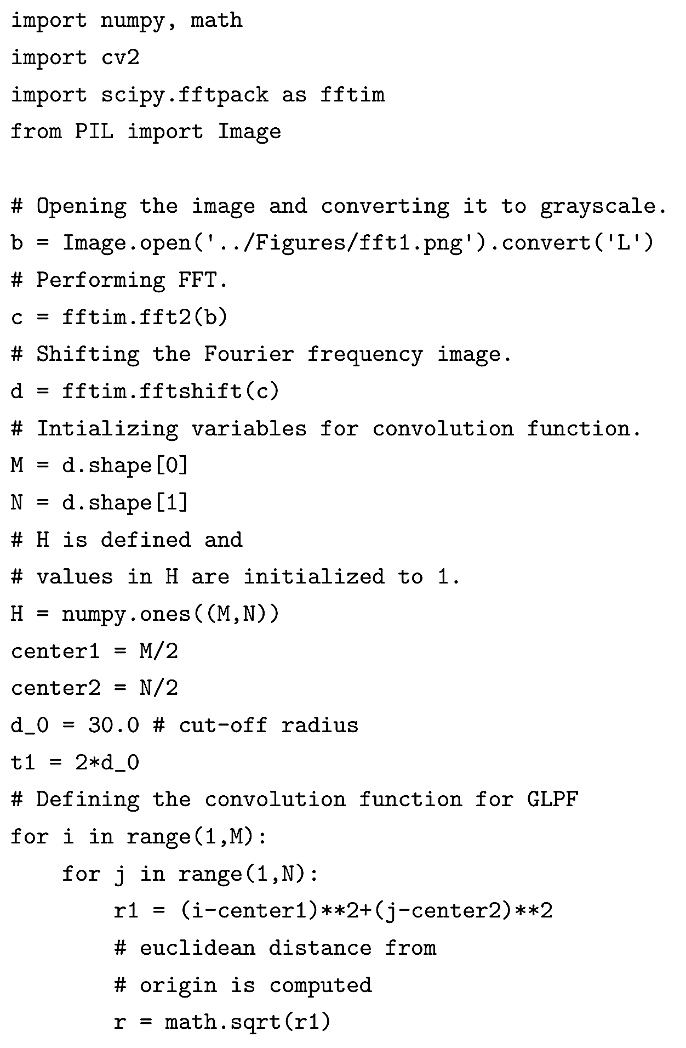
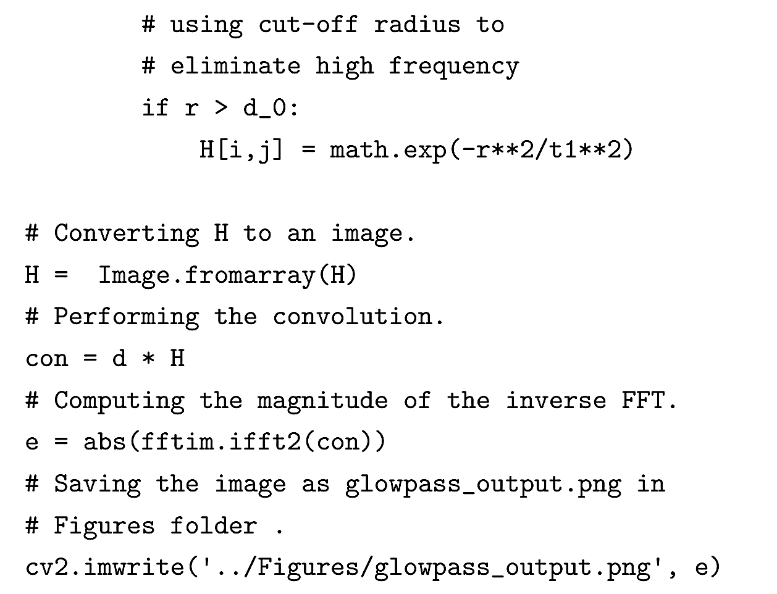
Gaussian Low-pass Filter (cont.)

Slide 29
Gaussian Low-pass Filter (cont.)
The ILPF is extremely blurred due to the sharp change in the ILPF convolution function at the cut-off radius. There are also severe ringing artifacts, the spaghetti-like structure in the background next to the foreground pixels.
In BLPF, the convolution function is continuous which results in less blurring and fewer ringing artifacts compared to ILPF.
Since a smoothing operator forms the GLPF convolution function, the output of GLPF is even less blurred when compared to both ILPF and BLPF.

Slide 30
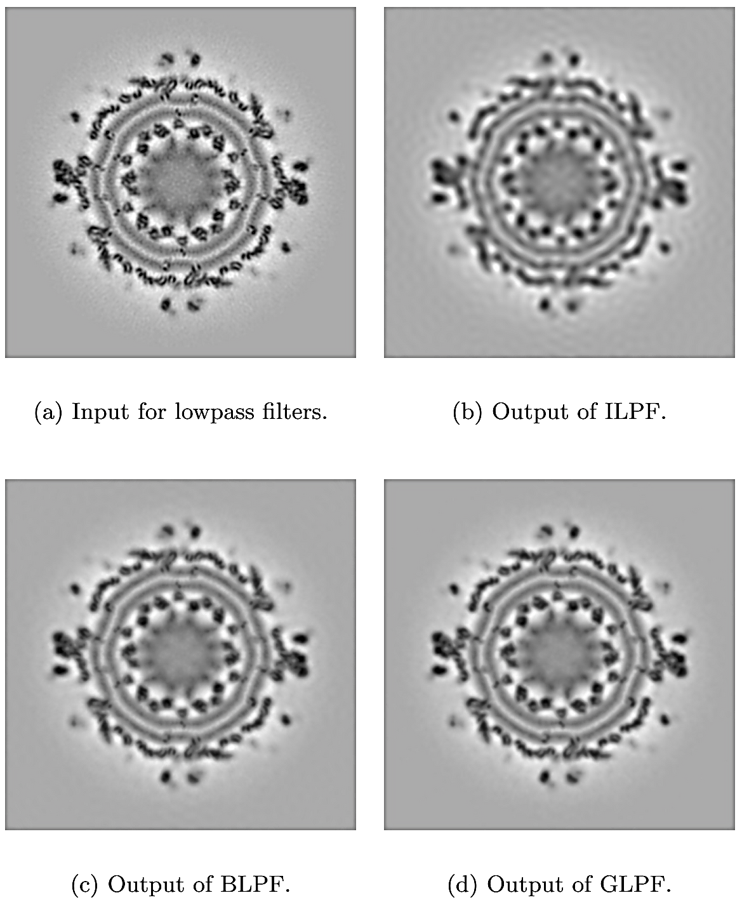
Comparison of Low-pass Filters

Slide 31
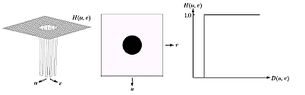
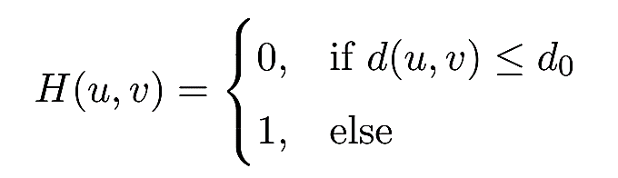
Ideal High-pass Filter
The convolution function for the 2D ideal high-pass filter (IHPF) is given by:
where d₀ is the cutoff frequency and d(u, v) is the Euclidean distance from the origin.

Slide 32
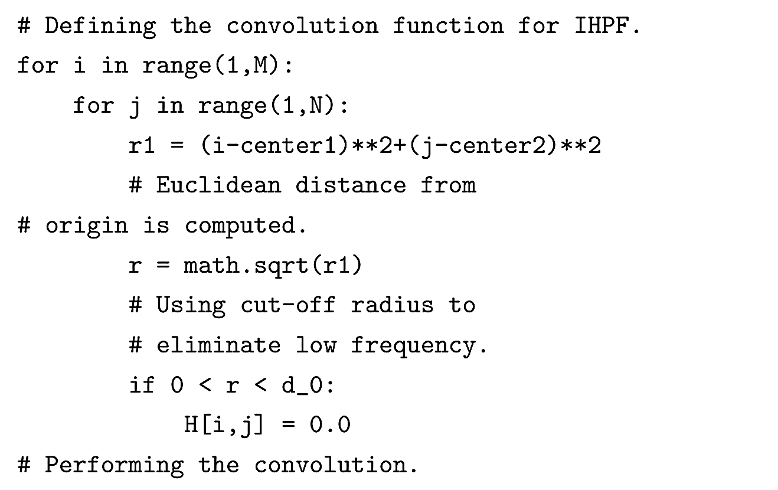
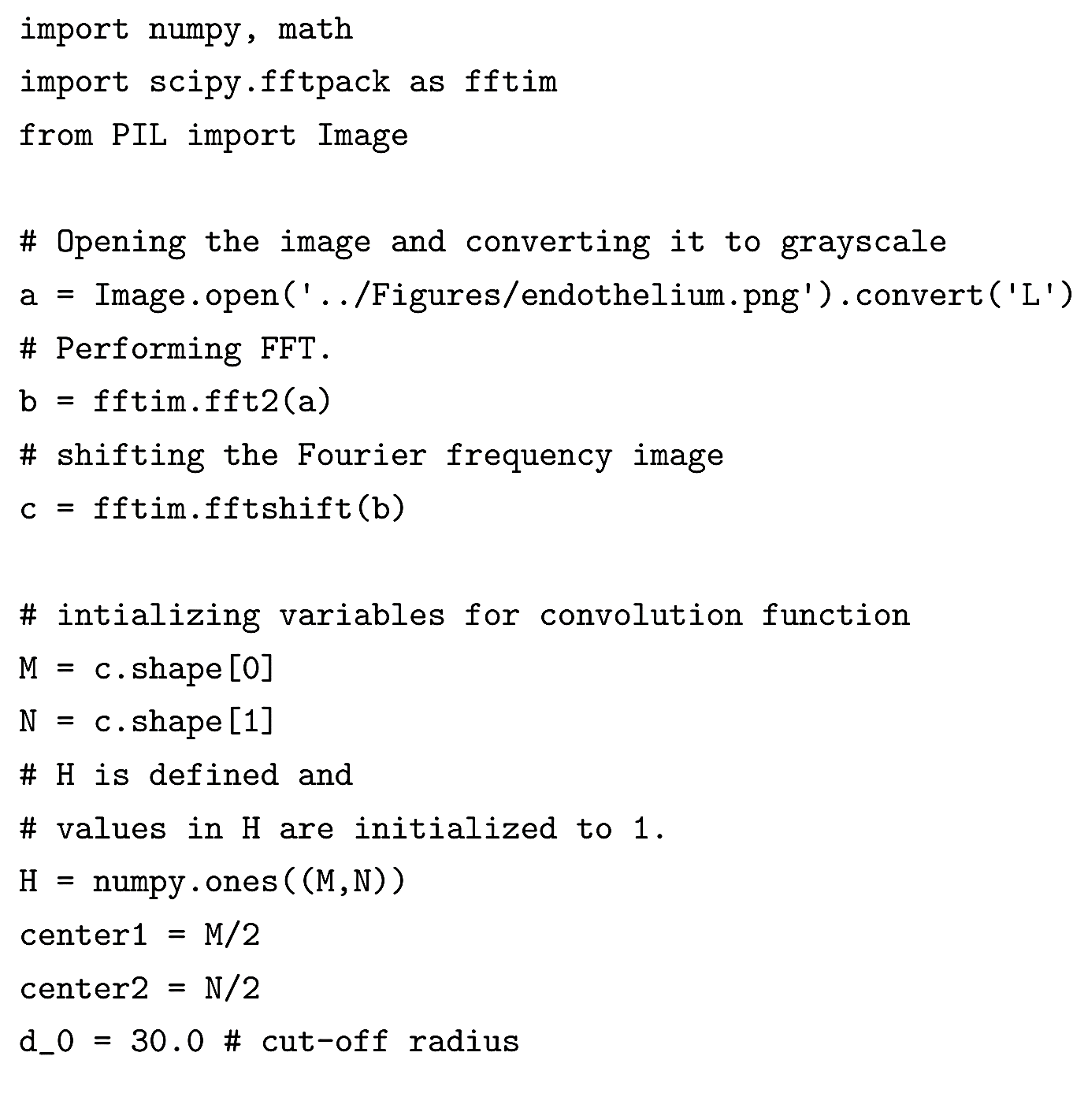
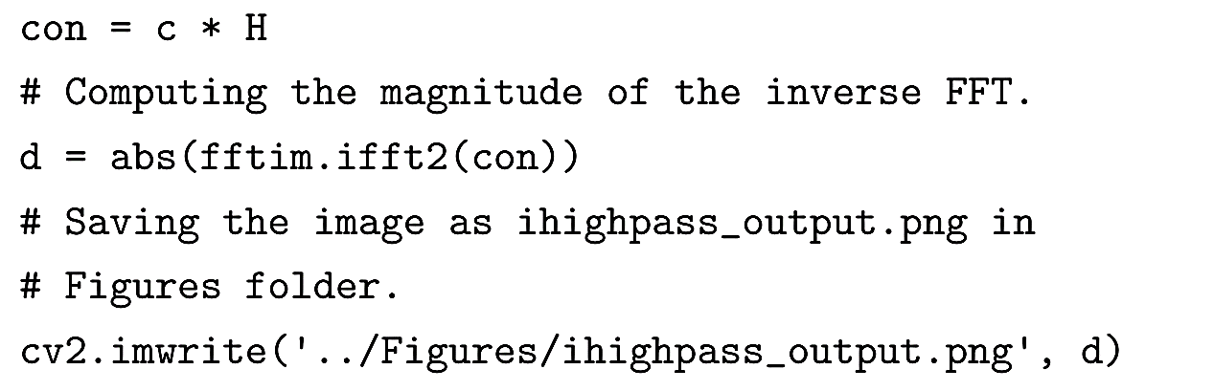
Ideal High-pass Filter (cont.)

Slide 33
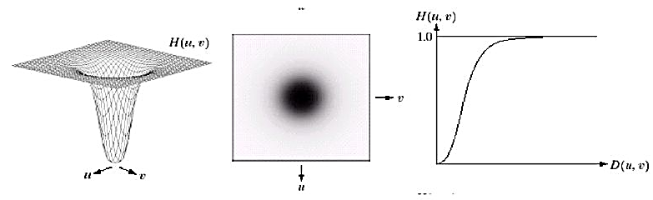
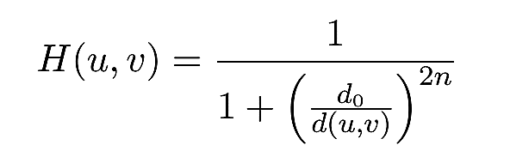
Butterworth High-pass Filter
The convolution function for the Butterworth high-pass filter (BHPF) is given below:
where d₀ is the cut-off frequency, d(u, v) is the Euclidean distance from the origin and n is the order of the BHPF.

Slide 34
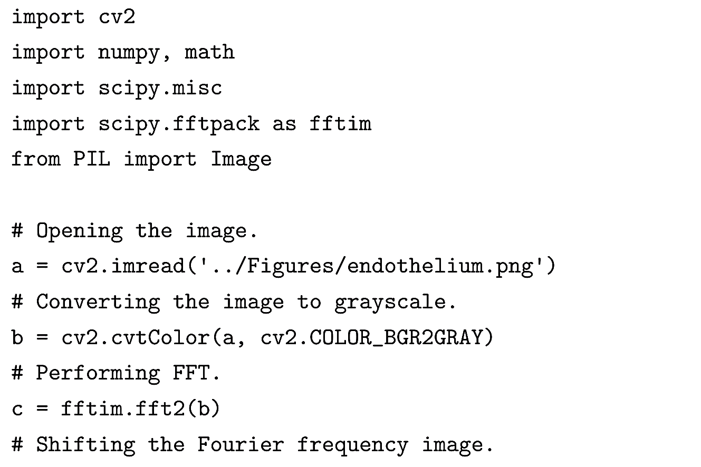
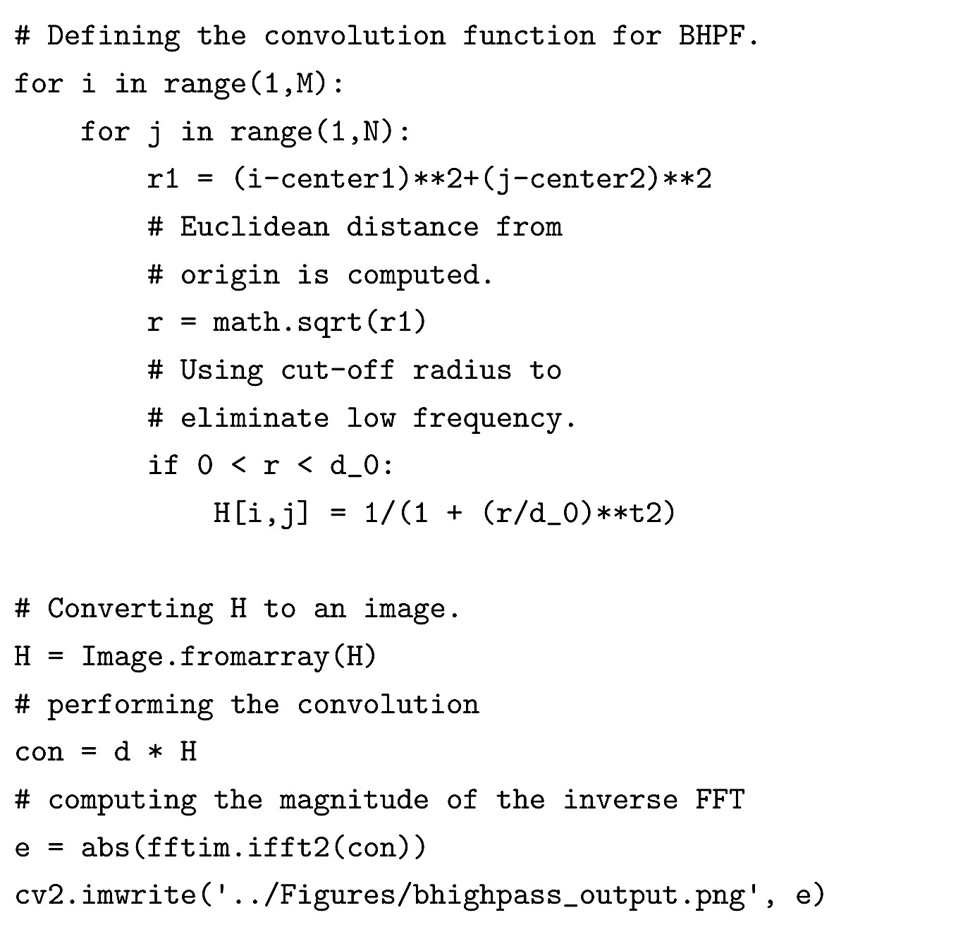
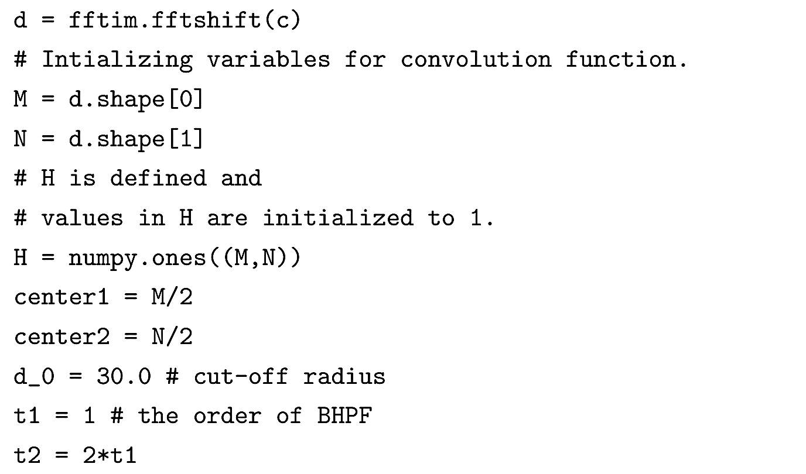
Butterworth High-pass Filter (cont.)

Slide 35


Gaussian High-pass Filter
The convolution function for the Gaussian high-pass filter (GHPF) is given below:
where d₀ is the cut-off frequency and d(u, v) the Euclidean distance from the origin.

Slide 36


Gaussian High-pass Filter (cont.)

Slide 37

Comparison of High-pass Filters

Slide 38

Band-pass Filter
A band-pass filter, as the name indicates, allows frequency from a band or range of values. All the frequencies from outside the band are set to zero.
Similar to the low-pass and high-pass filters, band-pass filters can be Ideal, Butterworth or Gaussian.
Let us consider the ideal band-pass filter, IBPF.

Slide 39



Band-pass Filter (cont.)

Slide 40

Band-pass Filter (cont.)

